Slide 1
eG Real User Monitor (RUM) Sizing Calculator
Date | Version
27-Aug-2015 | First version

Slide 2
Contents
Introduction to RUM sizing calculator xls
Sections within the calculator
Usage Instructions
FAQ

Slide 3
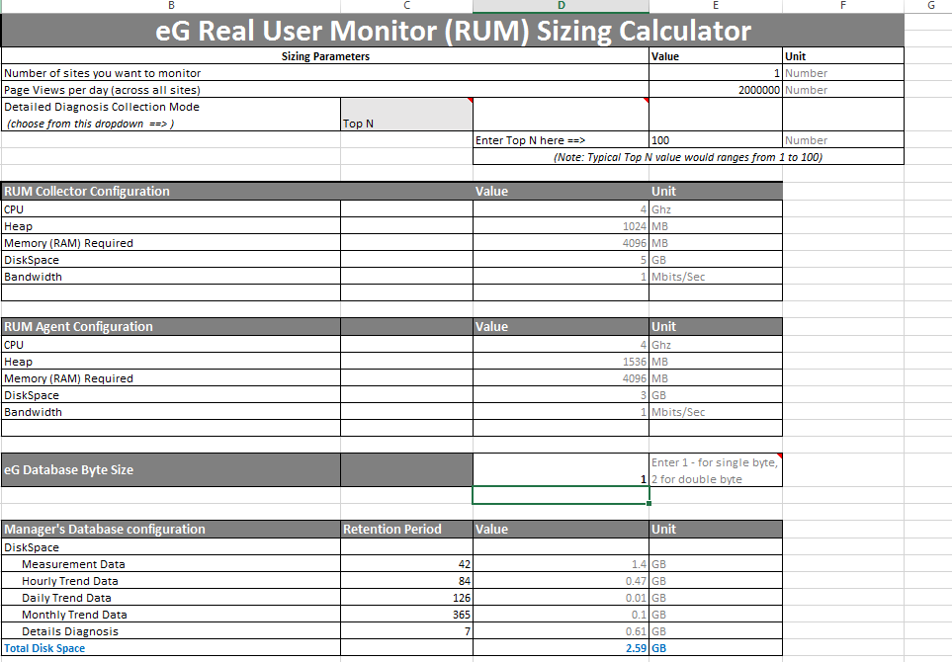
The Sizing Calculator is an excel document

Slide 4
You will need to enter your requirements in 3 places
1
Sizing params
2
Single byte/ double byte preference
3
DB Retention period

Slide 5
The calculator will provide 3 specific sizing recommendations
1
Sizing recommendation for Collector
2
Sizing recommendation for Agent
3
Sizing recommendation for Manager

Slide 6
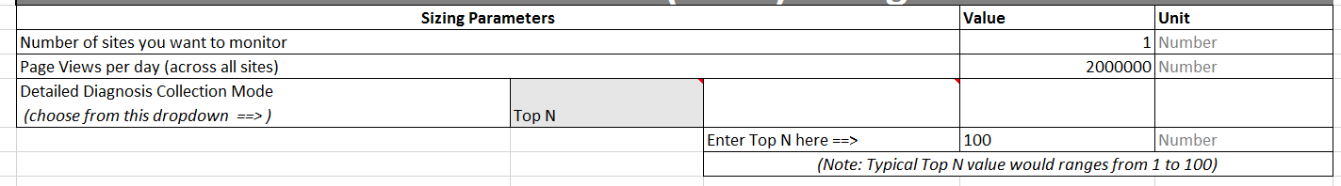
Usage Instructions
Let’s look at the first section

Slide 7
Usage Instructions
Specify the number web sites you want to monitor with eG RUM
Each site is considered as a separate RUM component

Slide 8
Usage Instructions
Enter the TOTAL page views per day across all web sites.
You will need to sum up the page views across all sites. Each page visit/hit is considered as a page view.
Note:
You will need to consider:
Base Page views
AJAX requests
IFrame requests

Slide 9
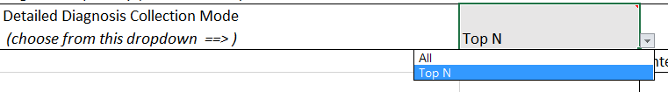
Choose Diagnosis Mode
Enter the Detailed Diagnosis (DD) Mode
There are 2 choices : “All” or “Top N”

Slide 10
Use the ‘All’ mode with caution!
When you choose the ‘All mode, the number of DD lines will equal the number of page views..
The ‘All’ mode is generally not recommended since this mode captures DD for all visits. This will result in the eG Database getting filled up at a faster rate and there will be potential impact on the eG Manager performance.

Slide 11
The Top N mode
The “Top N” Mode captures detailed diagnosis data for SLOW and ERROR pages per measurement period. The calculator constrains the Top N value to a range between 1 and 100.

Slide 12
DB Multilingual support
Specify the Manager Database is Double Byte enabled or not. This is for the purpose of Multilingual support.
Select 1 for single byte mode and 2 for double byte

Slide 13
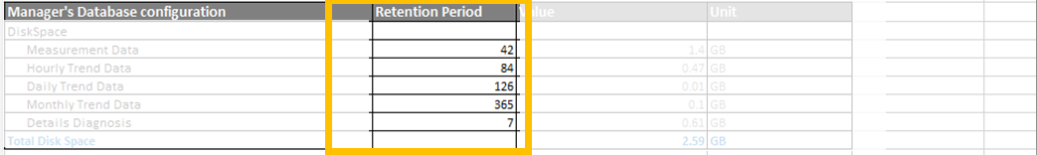
Choose the retention period for various types of data
Choose the desired retention period values

Slide 14
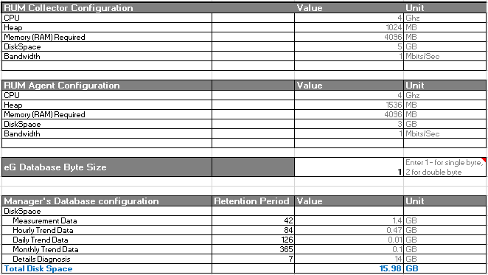
Sizing Recommendation Outputs

Slide 15
FAQ
Q: How did you arrive at the recommendations?
A: We conducted a series of benchmark load tests and captured the resource usage details for every segment of the eG RUM Infrastructure.
Q: What is the single most important parameter for sizing?
A: The page views per day is the single most important parameter.

Slide 16
FAQ
Q: It appears that the agent needs more memory than the collector. Why is this the case?
A: The collector does way less work when compared to the agent:
Collector: The collector simply receives the beacons from the browser, geocodes the request (which is a very low overhead operation) and subsequently stores the beacon data into a file.
Agent: The agent in contrast does way more work. It compares the data, categorizes by dimension, calculates the slow and error DD etc. This requires more memory to be provisioned on the agent.

Slide 17
FAQ
Q: I already have eG running for other monitors (eg Citrix, DB etc). How do I propose the capacity as an incremental addition over and above what is already running at the customer’s place (when they plan to install RUM)?
A: The RUM sizing calculator is specific for RUM deployments. This is over and above the existing eG Manager sizing calculator.
We are working on integrating the new RUM sizing calculator with the existing eG manager sizing calculator (via an excel macro). In the interim, please manually carry over the incremental sizing recommendations and provide a consolidated recommendation.

Slide 18
Questions?
Please email rumsupport@eginnovations.com

